Slide 1
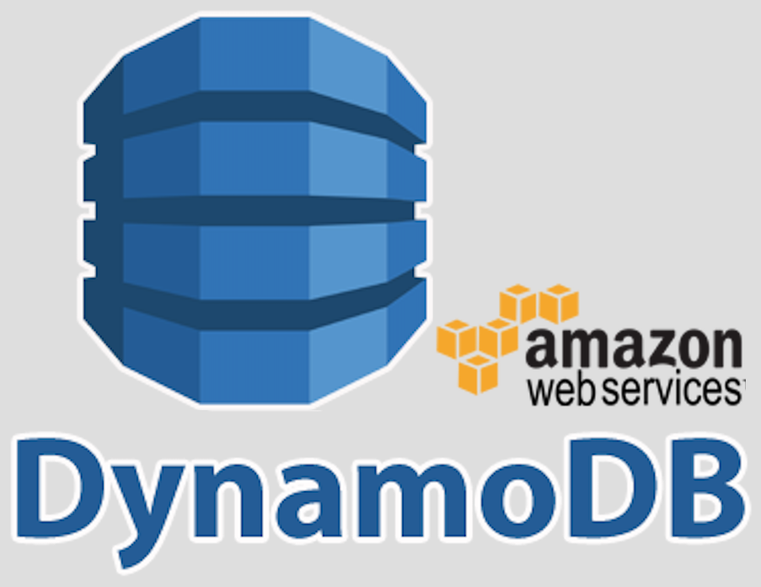

Slide 2
Amazon DynamoDB
Fast, flexible NoSQL database service for single-digit millisecond performance at any scale
fully managed, serverless, key-value NoSQL database designed to run high-performance applications at any scale.
built-in security, continuous backups, automated multi-Region replication, in-memory caching, and data export tools.

Slide 3
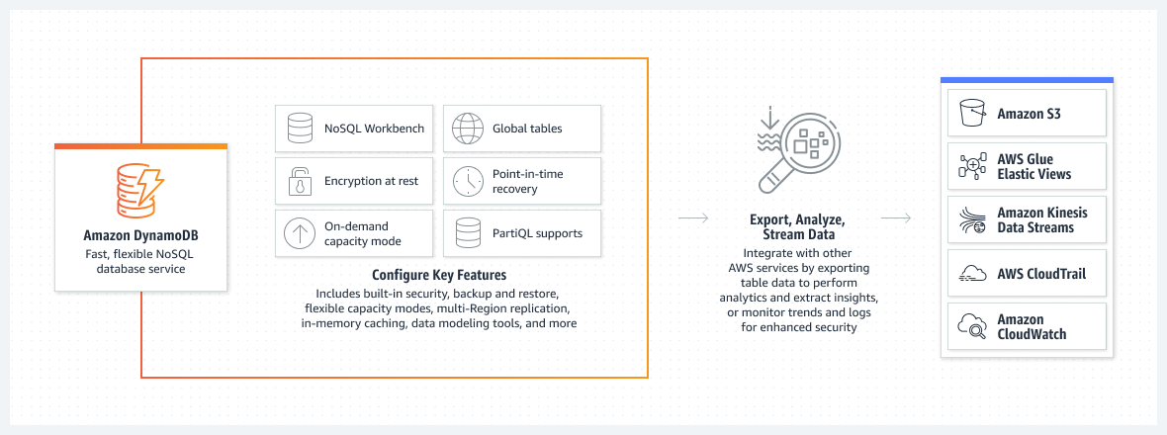
How it works

Slide 4
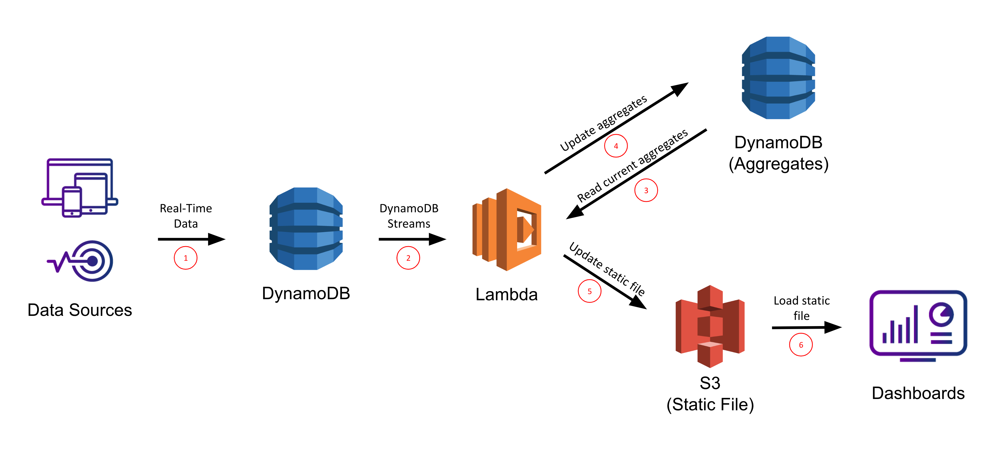

Slide 5




Use cases
Develop software applications
Create media metadata stores
Deliver seamless retail experiences
Scale gaming platforms

